Slide 1

Project Scheduling and Monitoring

Slide 2
Learning Objectives
Discuss the strategic planning process and apply different project selection methods
Explain the importance of creating a project charter to formally initiate projects
Describe project management plan development, understand the content of these plans, and review approaches for creating them (planning)

Slide 3
Learning Objectives
Explain project execution, its relationship to project planning, the factors related to successful results, and tools and techniques to assist in directing and managing project work
Describe the process of monitoring and controlling a project
Understand the integrated change control process, planning for and managing changes on information technology (IT) projects, and developing and using a change control system
Explain the importance of developing and following good procedures for closing phases/projects

Slide 4

What is Project Integration Management
Coordinating the other project management knowledge areas (project management processes/tasks) throughout a projects life cycle.
Ensures that all elements of a project come together at the right times to complete a project successfully

Slide 5
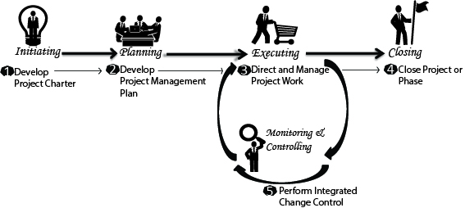
Project Integration Management Processes
Source: http://psemagazine.com/project-integration-management/

Slide 6
Project Integration Management Processes
1. Developing the project charter involves working with stakeholders to create the document that formally authorizes a project—the charter.
2. Developing the project management plan (creating a project proposal) involves coordinating all planning efforts to create a consistent, coherent document—the project management plan (various plans/documents- 9 knowledge Areas)
3. Directing and managing project work involves carrying out (executing) the project management plan by performing the activities included in it.

Slide 7
Project Integration Management Processes (cont’d)
Monitoring and controlling project work involves overseeing activities to meet the performance objectives of the project
Performing integrated change (part of monitor/ control) control involves identifying, evaluating, and managing changes throughout the project life cycle.
Closing the project or phase involves finalizing all activities to formally close the project or phase.

Slide 8
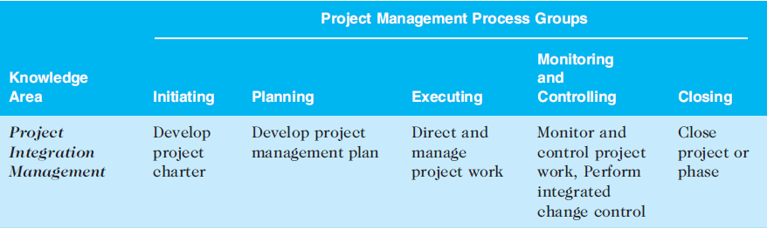

Project Integration Management Processes (cont’d)

Slide 9
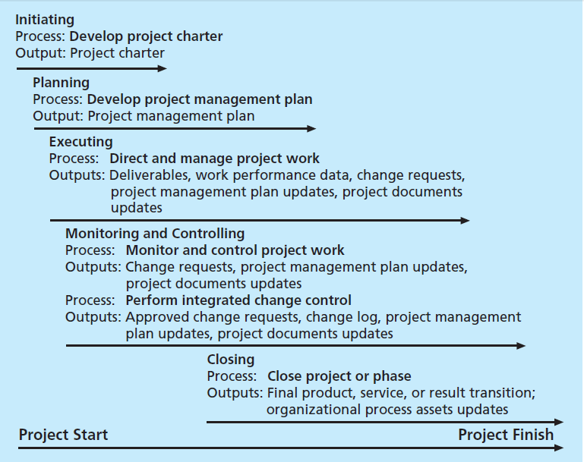
Project Integration Management Processes (cont’d)

Slide 10
Why Project Integration Management (PIM)?
PIM is considered to be critical to overall project success
PIM enables project managers to:
coordinate people, plans and work required to complete a project
focus on the big picture of the project and steer the project team towards successful completion
make swift decisions or empower someone in the team to make swift decisions (first time right decisions) when conflicts occur among project goals or people
communicate key project information to top management
effectively manage interface with stakeholders (provide stake holder satisfaction)
PM must establish and maintain good communication/relationship across organisation.
PIM must happen within the context of the entire organisation, not just within a project
PM must integrate the work of project with ongoing operations of the organisation
PIM- is project management based on 9 knowledge areas
PIM is what gets performed in projects to deliver the projects successfully

Slide 11
Strategic Planning and Project Selection
What project to pursue?
Should PMs be involved in decision making?
Usually it is the top management responsibility
Successful organisation know PMs can provide important information to help identify and select potential projects
PMs, Product Managers or IT managers must take part in Strategic Planning

Slide 12
Strategic Planning and Project Selection
Strategic planning involves determining long-term objectives, predicting future trends, and projecting the need for new products and services
Organizations often perform a SWOT analysis
analyzing Strengths, Weaknesses, Opportunities, and Threats
As part of strategic planning, organizations
identify potential projects
use realistic methods to select which projects to work on
formalize project initiation by issuing a project charter

Slide 13
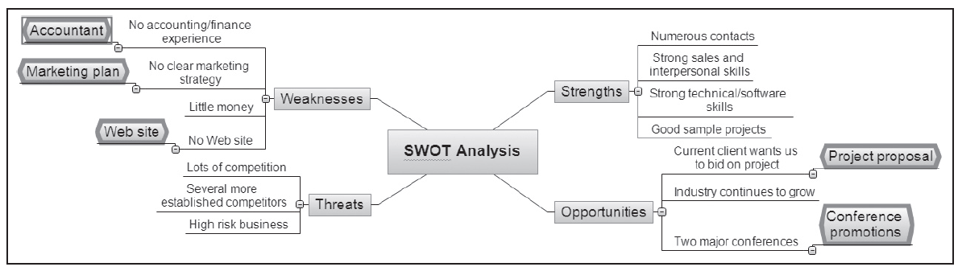
SWOT: Example: Four people who want to initiate a new business in the film industry

Slide 14
Methods for Selecting Projects
There are usually more projects than available time and resources to implement them
Methods for selecting projects include:
focusing on broad organizational needs
e.g. need to improve communication in the organization categorizing information technology projects -> projects that address this need
performing net present value or other financial analyses
using a weighted scoring model
implementing a balanced scorecard

Slide 15
Weighted Scoring Model
A weighted scoring model is a tool that provides a systematic process for selecting projects based on many criteria
Identify criteria important to the project selection process
Assign weights (percentages) to each criterion so they add up to 100%
Assign scores to each criterion for each project
Multiply the scores by the weights and get the total weighted scores
The higher the weighted score, the better (get higher priority)

Slide 16
WSM: (1) Identify criteria important to the project selection process - Example
Supports key business objectives
Has strong internal sponsor
Has strong customer support
Uses realistic level of technology
Can be implemented in one year or less
Provides positive NPV
Has low risk in meeting scope, time, and cost goals

Slide 17
WSM: (2) Assign weights (percentages) to each criterion so they add up to 100%
Criteria
Supports key business objectives
Has strong internal sponsor
Has strong customer support
Uses realistic level of technology
Can be implemented in one year or less
Provides positive NPV
Has low risk in meeting scope, time, and cost goals
Weight
25%
15%
15%
10%
5%
20%
10%
100%

Slide 18
WSM: (3) Assign scores to each criterion for each project
25%*90+15%*70+15%*50+10%*25+5%*20+20%*50+10%*20=56
Criteria
Supports key business objectives
Has strong internal sponsor
Has strong customer support
Uses realistic level of technology
Can be implemented in one year or less
Provides positive NPV
Has low risk in meeting scope, time, and cost goals
Weight
25%
15%
15%
10%
5%
20%
10%
100%
Project 1
90
70
50
25
20
50
20
56

Slide 19
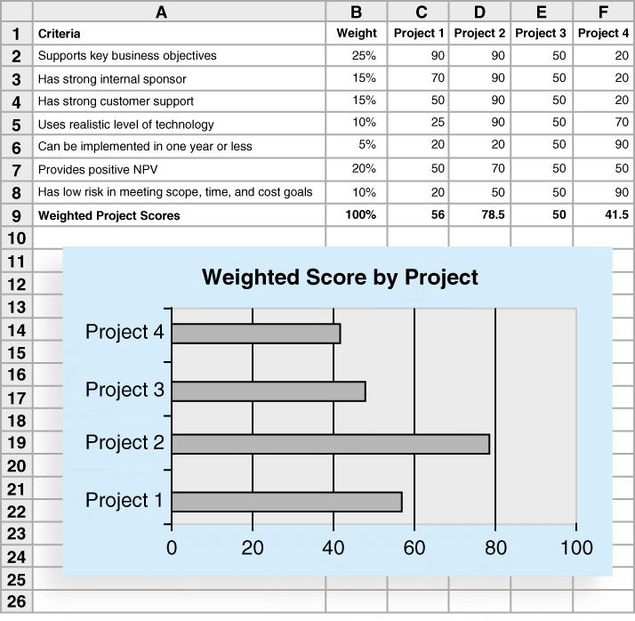
Figure 4-7. Sample Weighted Scoring Model for Project Selection

Slide 20
Which of the following processes is not part of project integration management?
developing the project business case
developing the project charter
developing the project management plan
closing the project or phase

Slide 21
Developing a Project Management Plan
A project management plan is a document used to coordinate all project planning documents and help guide a project’s execution and control
Plans created in the other knowledge areas are critical part of project management plan
i.e. plans and documents based on the other 9 knowledge areas are developed
→Project management plan (PMI knowledge area)

Slide 22
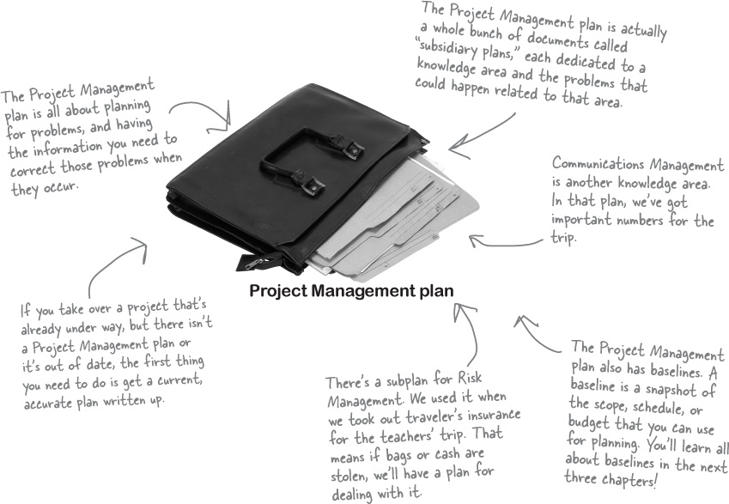
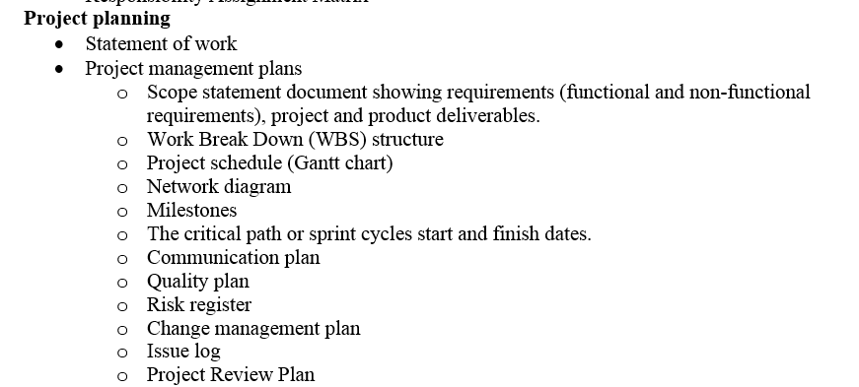
Developing a Project Management Plan
Source: https://www.safaribooksonline.com/library/view/head-first-pmp/9781449364908/ch04.html#exercise_solution-id00044

Slide 23
Common Elements of a Project Management Plan
1. Introduction or overview of the project
Project name, brief description of the project and the need it address (goals and reason for it), rough estimates (time & cost);
names of project manager (contact for project information) & key team members;
Deliverables of the project (project phase deliverables, software, hardware, technical report, training report)
List of reference material (reference and summarize the plans produced for other knowledge areas)
List of definitions (help to avoid confusion)
2. Description of how the project is organized
Organisational charts (sponsor)
Project responsibilities (identify project activities and people responsible for them)
Document any major processes to follow on projects

Slide 24
Common Elements of a Project Management Plan
3. Management and technical processes used on the project:
Management objectives; management view, any major assumptions or constraint
Project controls; how to monitor project progress (monthly or quarterly reviews); handle changes-what is the process for change control, level of management required to approve different types of changes.
Risk/Issue management; how the team will identify, manage and control risks/issues
Project staffing; number and types of people required on project
Technical processes; describes specific methodologies a project might use

Slide 25
Common Elements of a Project Management Plan
4. Work to be done,
Major work packages – summarize the main work packages (Work Breakdown Structure - WBS) for the project and refer to appropriate sections of the scope management plan
Other work related information – list hardware and software to be used on the project
5. Schedule information
Provide a summary overall project schedule (key deliverables and planned completion dates)
Detailed schedule; provide more detailed information about project schedule. It should reference the schedule management plan and discuss dependencies among project activities that could affect project activities (network diagram, critical path)
6. Budget information
Summary budget
Detailed budget

Slide 26
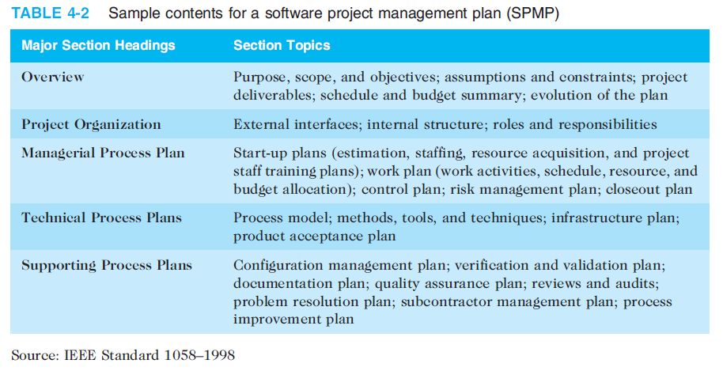
A Project Management Plan

Slide 27
Project Management Plan (PMP)
Produce varies plans& documents (we will learn them through other 9 knowledge areas
These plans & documents will used to write (justify and support) the section 1 to 6 shown in the template for PMP
Most sections of the PMP require providing summary from these plans & documents, the actual plans & documentation must be provided in appendix of the PMP
PMP is the proposal for undertaking the project which needs approval from the management before you can embark on the actual project work
Next year for R & D project paper your team will be required to do PMP
Present to get approval
Do the necessary changes
Then only your team will be allowed to carry out the project- work will be based on PMP

Slide 28
Directing and Managing Project Work (Execution of PMP)
Involves managing and performing the work described in the project management plan
The majority of time and money is usually spent on execution
The application area of the project directly affects project execution because the products of the project are produced during execution

Slide 29
Coordinating Planning and Execution
Project planning and execution are intertwined and inseparable activities
Those who will do the work should help to plan the work
Project managers must solicit input from the team to develop realistic plans

Slide 30
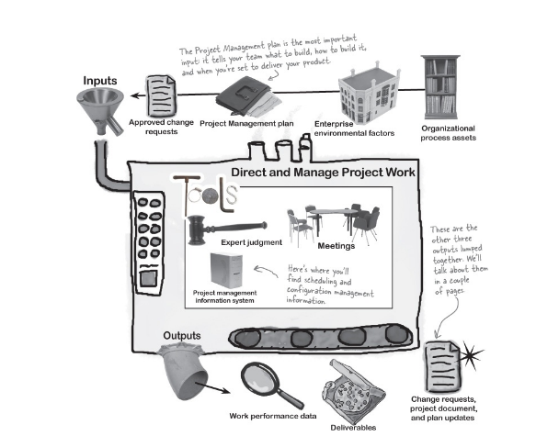
Coordinating Planning and Execution
Source: https://www.safaribooksonline.com/library/view/head-first-pmp/9781449364908/ch04.html#exercise_solution-id00044

Slide 31
Project Execution Tools and Techniques
Expert judgment: Experts can help project managers and their teams make many decisions related to project execution
Meetings: Meetings allow people to develop relationships, pick up on important body language or tone of voice, and have a dialogue to help resolve problems.

Slide 32
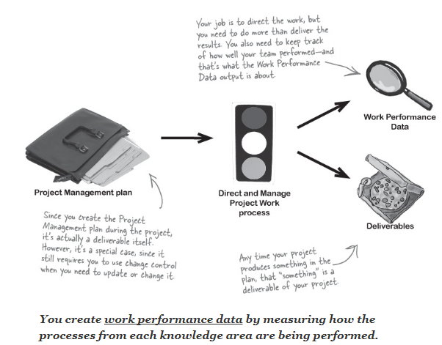

Directing and Managing Project Work (Execution of PMP)
Deliverables for
Assignment 1
Source: https://www.safaribooksonline.com/library/view/head-first-pmp/9781449364908/ch04.html#exercise_solution-id00044

Slide 33



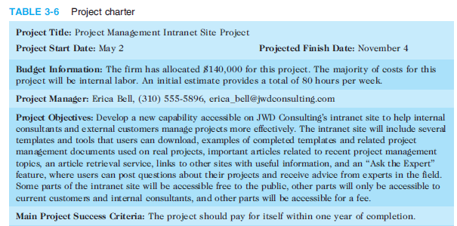
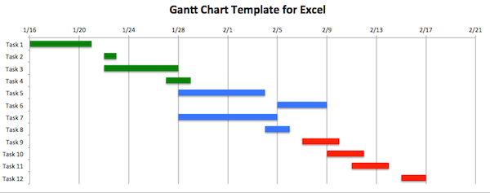

Deliverables-Examples
Deliverables

Slide 34
Monitoring and Controlling Project Work (including change management)
Changes are inevitable on most projects, so it’s important to develop and follow a process to monitor and control changes (change management plan in PMP)
Monitoring project work includes collecting, measuring, and disseminating performance information
A baseline is the approved project management plan plus approved changes

Slide 35
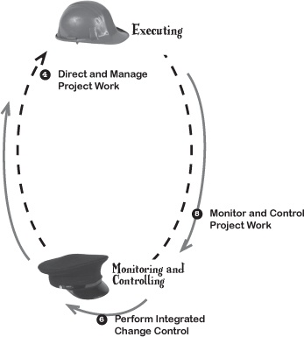
Monitoring and Controlling Project Work
Source: https://www.safaribooksonline.com/library/view/head-first-pmp/9781449364908/ch04.html#exercise_solution-id00044

Slide 36



Examples of Changes

Slide 37
Performing Integrated Change Control
Three main objectives are:
Influencing the factors that create changes to ensure that changes are beneficial
Determining that a change has occurred
Managing actual changes as they occur

Slide 38
Change Control System
A change control system is a formal, documented process that describes when and how official project documents and work may be changed
Describes who is authorized to make changes and how to make them

Slide 39
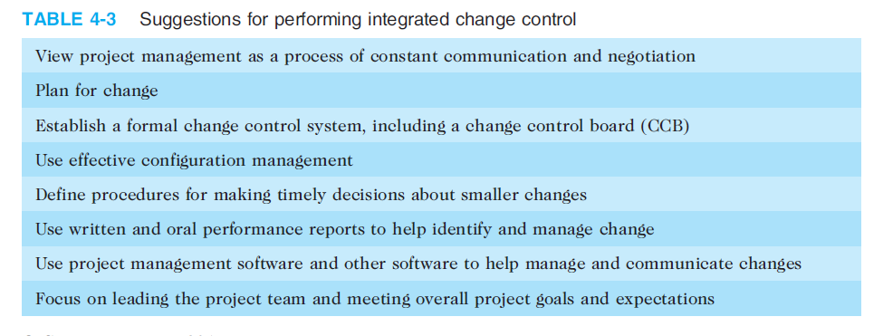
Performing Integrated Change Control

Slide 40
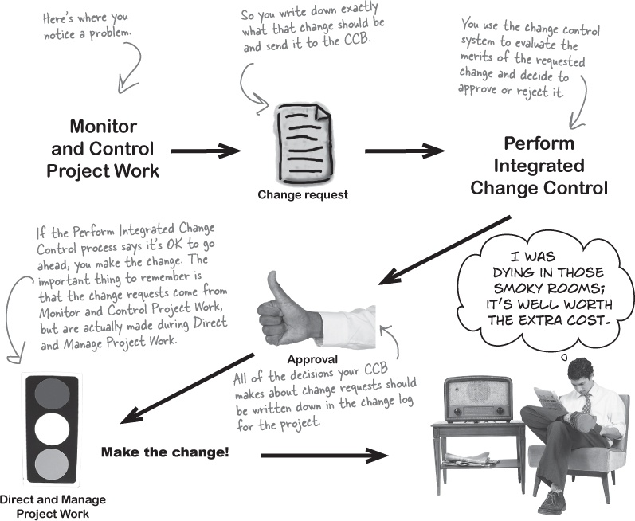
Performing Integrated Change Control
Source: https://www.safaribooksonline.com/library/view/head-first-pmp/9781449364908/ch04.html#exercise_solution-id00044

Slide 41
Closing Projects or Phases
To close a project or phase, you must finalize all activities and transfer the completed or cancelled work to the appropriate people
Main outputs include
Final product, service, or result transition
Organizational process asset updates

Slide 42
Case Study: Development of a Student Information System
The system supports about 3000 current students and about 1000 faculty members and staff (users).
The Project was broken into smaller projects.
Each small project was an R&D Project carried out by a group of 1 or 2 undergraduate students.
The Project started in 2006. The first version of the system was released in February 2007.
Currently, Version 3.0 has been released.
The whole project involved more than 80 undergraduates students and 25 internships.
Initial budget $ 0.
Initially, the system was hosted on a PC, later a server was bought.

Slide 43







Case Study: Development of a Student Information System
Dean of the Faculty of Science
Sponsor
Head of Student Records Office
Faculty Council
Sponsor
Sergio
Project Manager
Jossie
Project Manager
Lecturers
Students
Team Members

Slide 44
Case Study: Development of a Student Information System
Project charter: verbal commitment to complete the R&D project
Project management plan (creating a project proposal):
R&D proposal developed during the first semester, approved by the Head of Student Records Office, R&D supervisor, two or three lecturers
Each R&D team implemented the project management plan during its second semester
Monitoring and controlling activities were supported by the supervisor of each R&D project.
Performing integrated change: done by each R&D Team with the help of Sergio.
Each project was closed during the student final presentation of the R&D project to the supervisor and other lecturers.

Slide 45
Success of the project
Leadership
Clear goals
Student commitment
Good communication along the Project
Good understanding of the system requirements
Stakeholders were involved in the Project: student as programmers, lecturers as supervisors, faculty members as Project Managers.

Slide 46
A ________________is a document that formally recognizes the existence of a project and provides direction on the project’s objectives and management
project charter
contract
business case
project management plan

Slide 47
Chapter Summary
Project integration management involves coordinating all of the other knowledge areas throughout a project’s life cycle
Main processes include
Develop the project charter
Develop the project management plan
Direct and manage project execution
Monitor and control project work
Perform integrated change control
Close the project or phase

